Slide 1
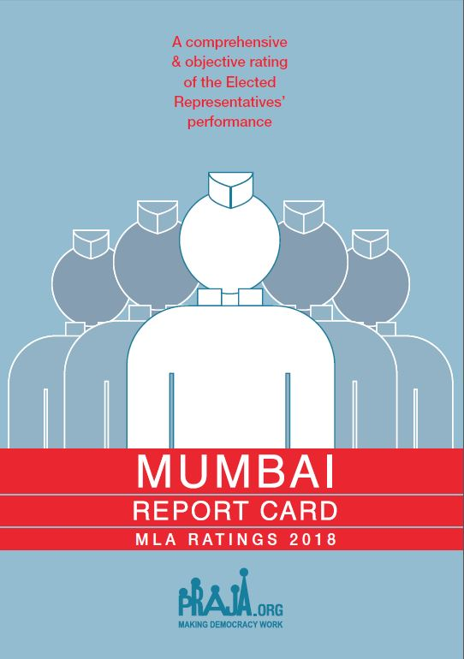


Slide 2
The Constitution as a Basis for monitoring of Elected Representatives
ERs derive their powers for functioning through the Constitution
They are mandated to Attend Sessions, Raise people’s Issues, Debate, Participate in Discussions and Pass legislations.
The Constitution defines their powers and rules of functioning, hence only the Constitution can provide the parameters for their monitoring.

Slide 3
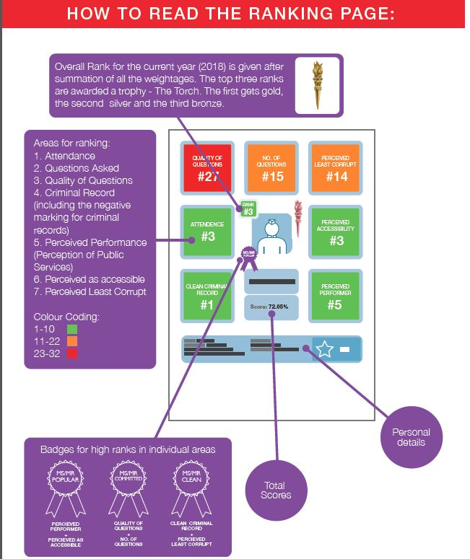

Slide 4
Parameters for Rating MLAs (1/4)
Parameter | Marks
Present¹(Attendance, No. & Quality of Questions, Usage of Area Development Fund) | 52
Past ²(Education qualification, PAN Card, Criminal cases) | 8
Perception (through an citizen survey of 24,290 people for their perception on their MLA’s accessibility/availability, performance, corruption, and satisfaction with quality of life, services provided by government) | 40
Negative for new FIR cases after 2014 election ³ | Minus 5
Negative for pending Charge Sheet ³ | Minus 5
Total | 100
RTI Data Source: ¹ Vidhan Bhavan and City & Suburban Collector Offices; ² Election Commission of India’s Website; ³ Mumbai Police.

Slide 5
Parameters for Rating MLAs (2/4)
Present Parameter (Marks)
Sessions Attended Based on percentage of attendance. 1) 100% to 91%- 10; 2) 90% to 76% - 8; 3) 75% to 61% -6; 4) 60% to 51% - 4; and 5) below 50% - 0 | 10
Number of Questions Asked Against Group Percentage Rank. 16 being the top most percentile and so on to the lowest for 1 | 16
Importance of questions asked Issues are given certain weightages depending on the importance of the issue as per the seventh schedule of the Constitution of India. Further weighted by the score for number of questions asked. | 21
Total Local Area Development Funds Utilised during April 2017 to March'2018 Calculation for the current financial year is done for the sanctioned fund of Rs. 2 crore.1) 100% (or more) to 91%- 5; 2) 90% to 76% - 4; 3) 75% to 61% -3; 4) 60% to 51% - 2; and 5) below 50% - 0 | 5

Slide 6
Parameters for Rating MLAs (3/4)
Past Parameter (Marks)
Education Qualification A minimum of 10th Pass - 1; if not – 0 | 1
Income Tax !) Possessing PAN Card - 1 2) Filling of last years IT returns – 1 | 2
Criminal Record If the candidate has zero cases registered against her/him, then 5; else as below: 1) Criminal Cases Registered containing the following charges: Murder, Rape, Molestation, Riot, Extortion - 0 2) Other criminal cases than the above mentioned – 3 | 5

Slide 7
Parameters for Rating MLAs (4/4)
Perception Parameter (Marks)
Perception of Public Services Score on Public Services | 20
Awareness & Accessibility Score on Awareness amongst people about their representative, their political party and ease of access to the representative | 6
Corruption Index Score on perceived personal corruption of the representative | 10
Broad Measures Score on overall satisfaction and improvement in quality of life | 4
Notes:
!) The weightage for Perception of Public Services was further divided into a hierarchy of 4 levels to meet the desired objective. Level 1 included facilities which are more critical to state government whereas Level 4 included facilities that are more critical to central government.
Level 1 – This level included areas like Power supply, Law & Order situation & Instances of crime. It was given a weightage of 8 points
Level 2 – This level included areas like Availability of food through ration shops & Pollution problems. It was given a weightage of 5 points
Level 3 – This level included areas like Hospitals & other Medical facilities & Appropriate Schools & Colleges. It was given a weightage of 4 points
Level 4 – This level included rest of the areas like Condition of Roads, Traffic Jams & Congestion, Availability of public gardens, Availability of public transport facilities, Water Supply, Water logging problems & Cleanliness & Sanitation facilities. It was given a weightage of 3 points
2) Broad Overall Measures: included opinions on Satisfaction with the MLA and Improvement in Lifestyle.

Slide 8
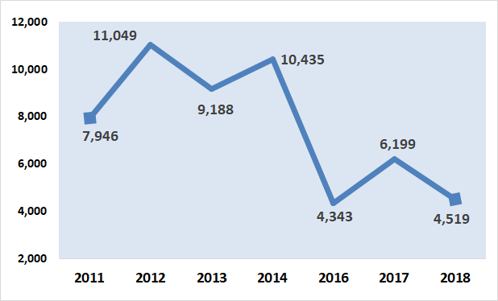
No. of Questions Asked by 32 MLAs
Period covered in Report Cards – 2011: Winter’09, Budget’10 & Monsoon’10; 2012: Winter’10, Budget’11 & Monsoon’11; 2013: Winter’11, Budget’12 & Monsoon’12; 2014: Winter’12, Budget’13, Monsoon’13 & Winter’13; 2016: Winter’14, Budget’15 & Monsoon’15; 2017: Winter’15, Budget’16 & Monsoon’16; and 2018: Winter’16, Budget’17, GST’17 & Monsoon’17.

Slide 9
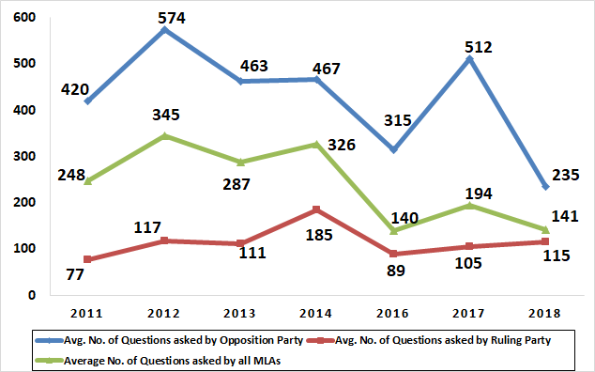
Average Number of Question Asked by MLAs
Term | Ruling Party | Opposition Party
Last term | INC(14) + NCP(2) = 16 | BJP(5) + MNS(6) + SS(4) + SP(1) = 16
Current Term | BJP(12) + SS(13) = 25 | INC(5) + SP(1) + AIMIM(1) = 7

Slide 10
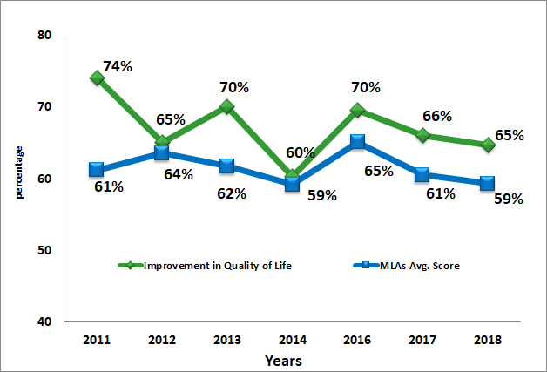
Average Score & Improvement in Quality of Life
In 2015, because it was the first year of the MLAs new term, they were not ranked

Slide 11
Key Insights
The average score of Attendance of members of legislative assembly (MLAs) in Mumbai has reduced by 10.63% from 91.88% in the report card of 2017 (Winter’15, Budget’16 & Monsoon’16) to 81.25% in 2018 (Winter’16, Budget’17, GST’17 & Monsoon’17).
Accessibility of MLAs has increased from 45.55% in 2017 to 53.31% in 2018.
The quality of questions is on a decreasing trend too. It has significantly dropped from 58.49% in 2016 to 38.18% & 38.36% in 2017 & 2018 respectively.

Slide 12
MLAs with criminal cases as per
Representative of People’s Act 1951
53% (19 out of 36) MLAs have criminal cases (FIRs) registered against them.
There is an 8% increase in the charge-sheets against MLAs. In the report card of 2018, 16 MLAs (44%) have charge-sheets against them, in comparison to 13 MLAs (36%) in 2017.
Note: This data includes all four designated ministers along with 32 MLAs.
Notes:
Ideology and No Social Service

Slide 13
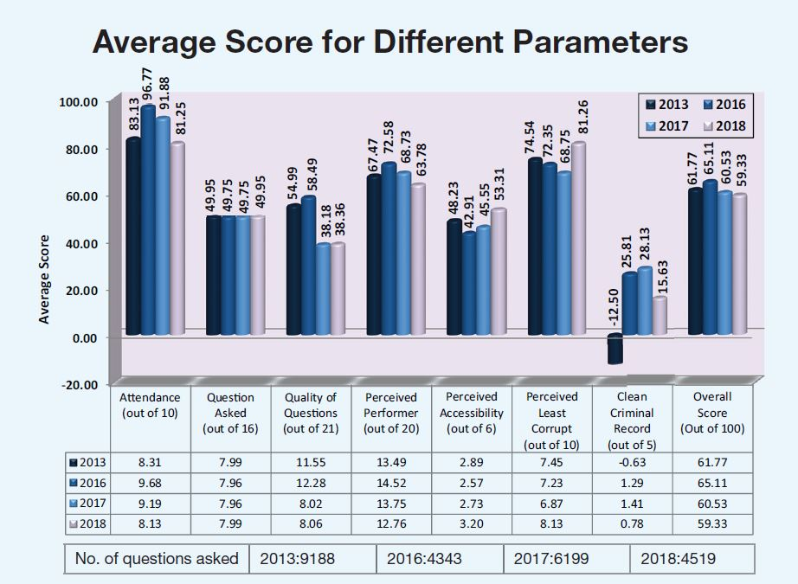
Note: Scores for the corresponding year (2013) in the last term have been given for comparison with the current year (2018).

Slide 14
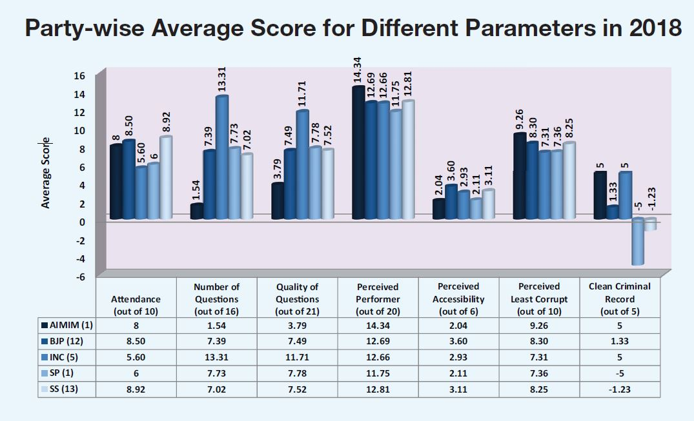
Party wise Ranking in 2018
Political Party | Average Score | Average Rank
AIMIM (1) | 54.59 | 23
BJP (12) | 59.92 | 15
INC (5) | 68.22 | 8
SP (1) | 48.37 | 26
SS (13) | 56.58 | 19

Slide 15
Party | MLAs Name | 2017 |  | 2018
 |  | Score | Rank | Score | Rank
INC | Amin Amir Ali Patel | 78.25 | 1 | 76.45 | 1
SS | Sunil Waman Prabhu | 73.17 | 5 | 75.61 | 2
BJP | Atul Bhatkhalkar | 72.79 | 6 | 74.67 | 3
SS | Sunil Govind Shinde | 69.26 | 9 | 72.69 | 4
INC | Aslam Ramazan Ali Shaikh | 74.12 | 3 | 72.31 | 5
BJP | Manisha Ashok Chaudhary | 68.32 | 11 | 70.94 | 6
BJP | Yogesh Sagar | 70.20 | 8 | 66.90 | 7
BJP | Ashish Babaji Shelar | 68.56 | 10 | 66.16 | 8
INC | Varsha Eknath Gaikwad | 72.28 | 7 | 65.97 | 9
BJP | Ameet Bhaskar Satam | 62.52 | 13 | 65.95 | 10
SS | Trupti Prakash Sawant | 57.84 | 19 | 64.91 | 11
BJP | Sardar Tara Singh | 65.84 | 12 | 64.60 | 12
INC | Md. Arif (Naseem) Lalan Khan | 73.87 | 4 | 63.43 | 13
INC | Kalidas Nilkanth Kolambkar | 74.93 | 2 | 62.93 | 14
SS | Prakash Vaikunt Phaterpekar | 56.94 | 21 | 62.30 | 15
BJP | Mangal Prabhat Lodha | 58.20 | 18 | 61.20 | 16
SS | Ajay Vinayak Choudhari | 59.15 | 16 | 60.55 | 17
SS | Prakash Rajaram Surve | 52.63 | 24 | 59.35 | 18
BJP | Parag Madhusudan Alavani | 57.54 | 20 | 58.25 | 19
BJP | Raj Purohit | 60.79 | 14 | 57.82 | 20
BJP | Bharati Hemant Lavekar | 53.91 | 23 | 57.46 | 21
SS | Mangesh Anant Kudalkar | 55.83 | 22 | 54.73 | 22
AIMIM | Waris Yusuf Pathan | 51.24 | 27 | 54.59 | 23
SS | Tukaram Ramkrishna Kate | 44.70 | 31 | 52.39 | 24
SS | Sunil Rajaram Raut | 59.81 | 15 | 48.68 | 25
SP | Abu Asim Azmi | 58.46 | 17 | 48.37 | 26
SS | Ramesh Kondiram Latke | 48.11 | 28 | 48.24 | 27
SS | Ashok Dharmaraj Patil | 46.50 | 29 | 46.48 | 28
SS | Sadanand Shankar Sarvankar | 51.41 | 26 | 45.36 | 29
SS | Sanjay Govind Potnis | 51.65 | 25 | 44.27 | 30
BJP | Selvan R. Tamil | 46.18 | 30 | 41.74 | 31
BJP | Ramchandra Shivaji Kadam | 41.96 | 32 | 33.37 | 32

Slide 16
THANK YOU!!!

